Slide 1
🚕
FINAL PROJECT | DOING DATA SCIENCE
NYC Yellow Taxi
Tip Prediction
Predicting tip behavior from NYC yellow taxi trip data
using machine learning and interactive tooling.
Isabella Westlauer · Josh Samuel
NYC Yellow Taxi Tip Prediction

Slide 2
OVERVIEW
Agenda
Project Goal
Data Overview
1
Introduce the prediction question, business motivation, and what success looks like.
2
Summarize the source data, key variables, and target outcome.
EDA + Data Quality
Modeling Workflow
3
Highlight major patterns, missing values, and outlier treatment.
4
Show feature engineering, models tested, and evaluation strategy.
RShiny App
RAG + Takeaways
5
Demonstrate the interactive interface and user-facing value.
6
Explain the retrieval component, lessons learned, and next steps.

Slide 3
PROBLEM FRAMING
Project Goal
Core question
Main Findings
How accurately can we predict tip behavior for NYC yellow taxi rides using trip, fare, and payment-related features?
1. The model achieved the desired predictive performance.
2. The model satisfied the required prediction benchmarks.
3. The residuals were not fully normal, and a small number of potentially influential observations remained.
4. The log-linear model with a quadratic term for fare amount provided the best overall fit.
Can we predict how much a rider will tip, and what can we learn about tipping behavior in NYC Yellow Taxis?
Tip prediction is a microcosm for complex, human-driven predictive modeling.
We predict tip amount to be relatively well-correlated with fare amount, possibly with seasonal variation depending on time of the year.
Prediction Model Target RMSE ≤ 2 and MAE ≤ 1.5
2025 NYC Yellow Taxi Data from nyc.gov
Impacts business profitability by optimizing data-driven decisions

Slide 4
DATASET
Data Overview
Dataset facts
Candidate features
Source: https://www.nyc.gov/site/tlc/about/tlc-trip-record-data.page records for January 1 – December 31, 2025
Size: after filtering and sampling, 10,008 observations of 14 variables
Unit of analysis: one row represents one taxi trip.
Target variable: tip amount in $USD
Pickup / dropoff datetime
Trip distance
Passenger count
Fare amount
Trip month
Pickup / dropoff zone

Slide 5
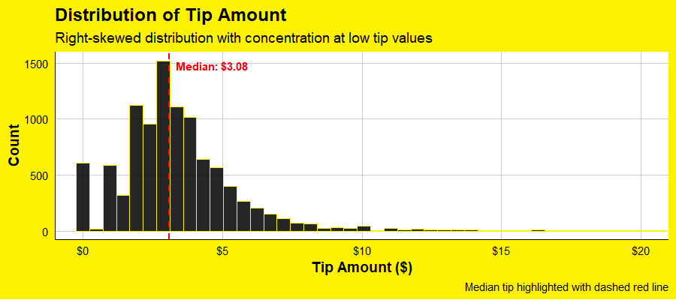
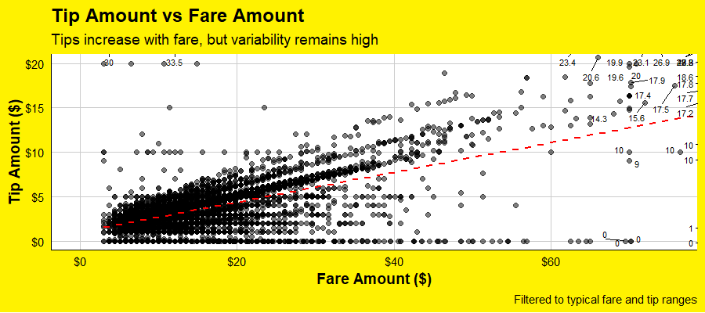
EXPLORATION
Exploratory Data Analysis
Distribution
Patterns
Tip amounts range from $0 to well over $20, with most tips between $0-$10
An estimate of the slope shows for every $6 the fare increases, the tip increases $1

Slide 6
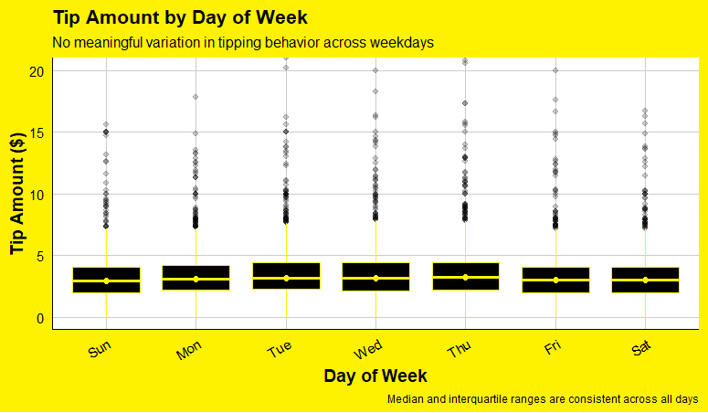
EXPLORATION
Time Series Analysis
Distribution
Patterns
Tip amount usually varies between $0-$4
Tipping behavior does not appear to vary by month or day of the week but rises with pickup times at midday.

Slide 7
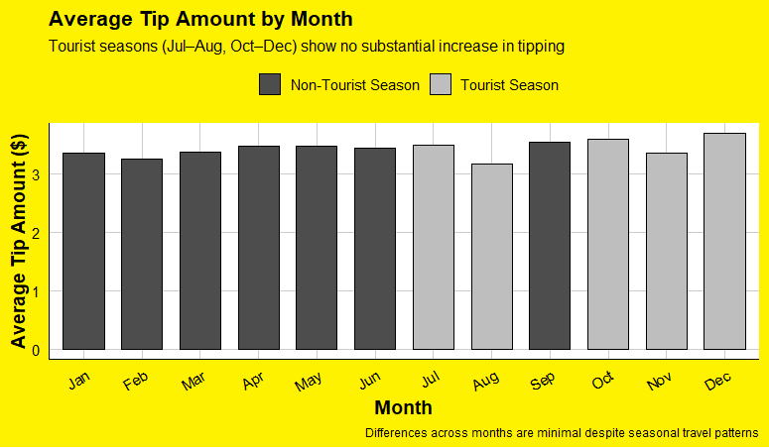
EXPLORATION
Time Series Analysis
Distribution
Patterns
Tip amount usually varies between $0-$4
Tipping behavior does not appear to vary by month or day of the week but rises with pickup times at midday.

Slide 8
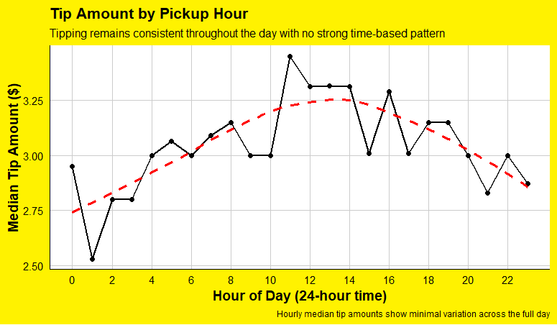
EXPLORATION
Time Series Analysis
Distribution
Patterns
Tip amount usually varies between $0-$4
Tipping behavior does not appear to vary by month or day of the week but rises with pickup times at midday.

Slide 9
EXPLORATION
Exploratory Data Analysis
Insight #1
Insight #2
Insight #2
Total Amount has a high correlation with tip amount, but may not be used as a predictor because it actually includes tip.
Insight 2
Insight 3

Slide 10
CLEANING
Missing Values and Outliers
Missing values
Outlier handling
Passenger count was N/A for 22% of observations
Fare amounts and tip amounts had negative values
Filtered out observations:
negative fares and tip amounts
0-minute trips
For model training, we used
Note how cleaning improved model reliability.
Before
Removed
After
—
—
—

Slide 11
FEATURES + MODELS
Model Building
Pipeline outline
Models tested
Response and predictors were filtered to within the 1% - 99% quantile
Model without interaction
add metric
1
A linear regression model was fit on the quadratic of fare amount, and “extra” fees.
2
Model with interaction
add metric
The residual show a noticeable tail in the Q-Q plot
3
Final model
add metric
The final model was chosen based on the lowest RMSE and MAE
4
Swap with your actual model names and metric values.

Slide 12
RESULTS
Model Performance
Best model
Primary metric
Interpretation
Add model
1.244
±$1.24
Name the final model selected.
RMSE
The predicted tip is within $1.24.
Model comparison table
Model
RMSE
MAE
Notes
Baseline
—
—
—
Model 2
—
—
—
Final
—
—
—

Slide 13
RESULTS
Model Limitations
Number of Predictors
Limited Response
Precision
2
Tip ≠ $0
moderate
“extra”, “fare amount”
not driven by observable trip characteristics
The predicted tip is within 40% of the median.
Model comparison table
Model
RMSE
MAE
Notes
Baseline
—
—
—
Model 2
—
—
—
Final
—
—
—

Slide 14
DEPLOYMENT
RShiny App
App screenshot placeholder
What to explain
Replace this space with a screenshot of the RShiny app home screen or prediction interface.
What the user can input
What the app predicts or displays
How the app makes the project more interactive
Why deployment matters beyond just training a model
Input controls
Prediction output
Filters
Visual feedback

Slide 15
EXTENSION
RAG Component
Retrieve
Generate
Connect
RAG system retrieves final project Rmd, data dictionary, and a project FAQ.
Explain what the user asks and what kind of response the system produces.
Clarify how the RAG feature complements the prediction model rather than replacing it.
Simple way to present it
"We added a retrieval-augmented generation component so users can ask natural-language questions about the project or results and receive answers grounded in project-specific information."
Edit this wording to match your actual implementation.

Slide 16
CLOSING SLIDE
Key Takeaways
Finding
Limitation
Next Step
State the main result from your project.
Mention one realistic limitation of the data or model.
Describe one improvement you would make in future work.
Thank you
Isabella Westlauer · Josh Samuel
NYC Yellow Taxi Tip Prediction · MSDS 6306 Doing Data Science

